Slide 1
A Restricted Black-box Adversarial Framework Towards Attacking
Graph Embedding Models
Members: 朱偉綸、黃秉茂、許齊崴

Slide 2
Abstract

Slide 3
Graph Embedding Model can effectively transform Node information, but is vulnerable to specific adversarial attacks
Many researches now focus on White-box Attack, which can learn information such as model, model parameters, gradient direction, etc.
This research proposes GF-Attack to attack Graph Embedding Model from the perspective of Graph Signal Processing

Slide 4
Introduction

Slide 5
We try to understand the graph embedding model from a new perspective and propose an attack framework: GF-Attack, which can perform adversarial attack on various kinds of graph embedding models.
We formulate the graph embedding model as a general graph signal processing with corresponding graph filter which can be computed by the input adjacency matrix.
GF-Attack is capable to perform the adversarial attack on any graph embedding models which can be formulate to a general graph signal processing.

Slide 6
Preliminary

Slide 7
GNN
除了feature還考慮關係
Spectral-Based Convolution
將Graph Data與Graph Filter都做Fourier Transform，也就是將Graph Data與Graph Filter從Spatial Domain轉換至Frequency Domain，如此一來對要Graph Data做Convolution直接相乘就好，比較簡單，做完後再將Graph Data做Inverse Fourior Transform，使其從Frequency Domain變回Spatial Domain。

Slide 8
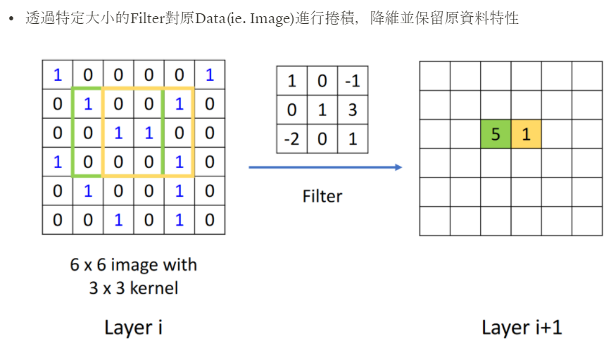
Convolution

Slide 9
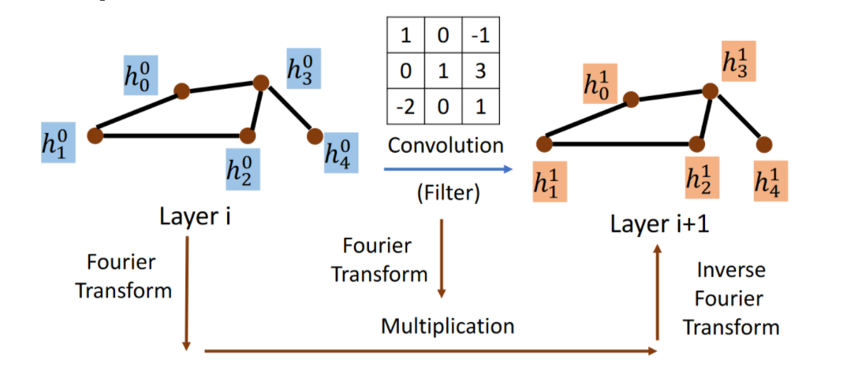

Slide 10
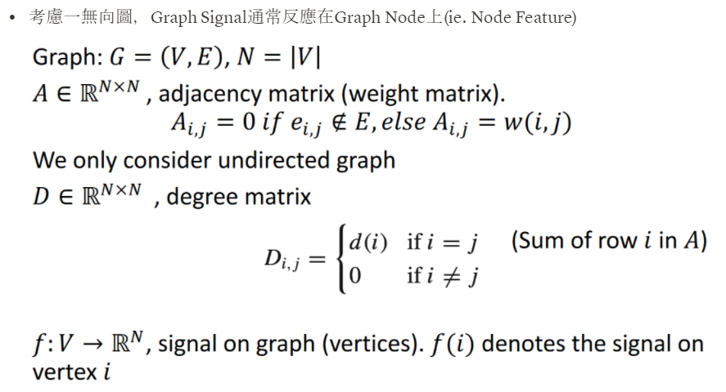
Spectral Graph Theory

Slide 11
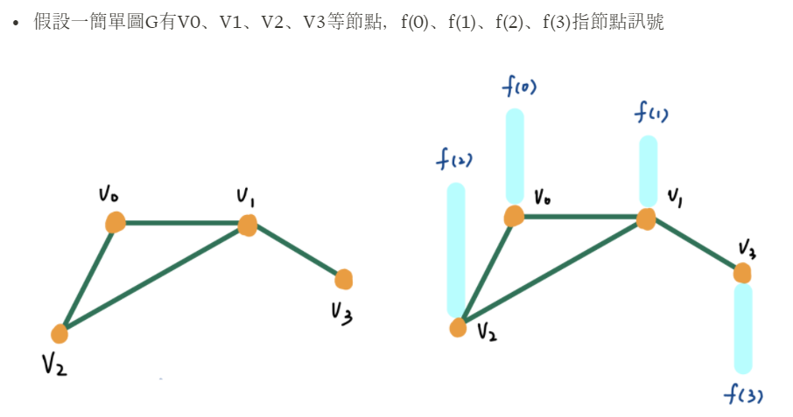
Spectral Graph Theory

Slide 12
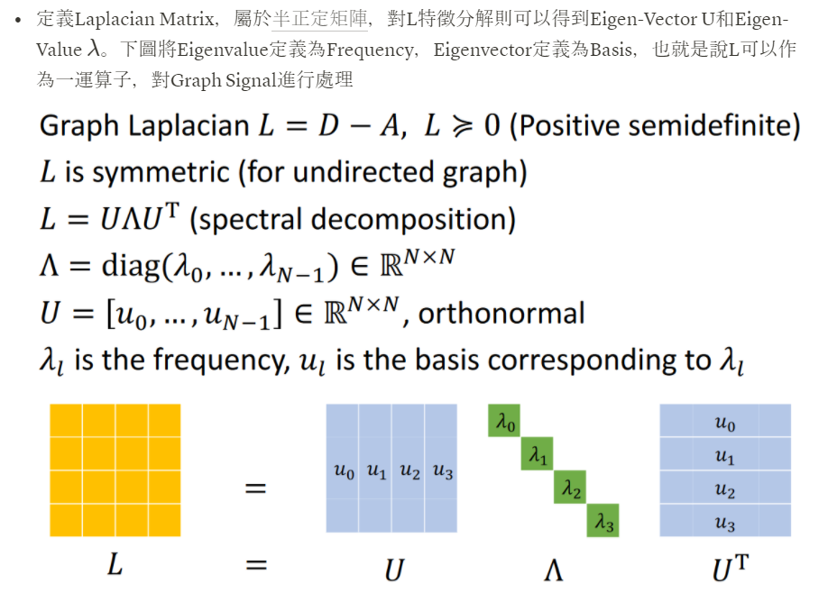
Spectral Graph Theory

Slide 13
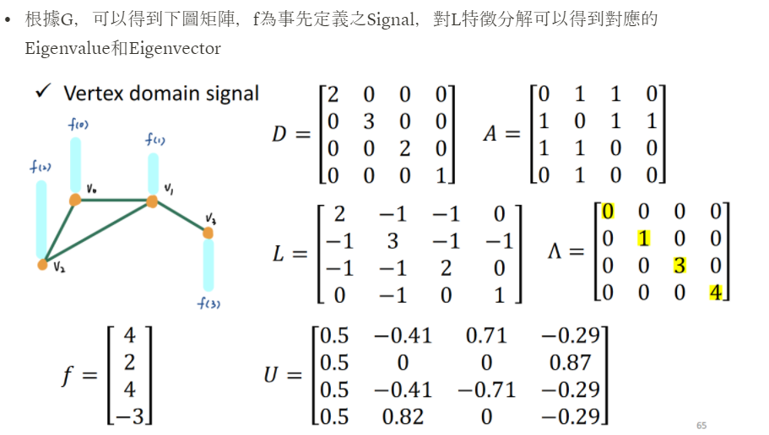
Spectral Graph Theory

Slide 14
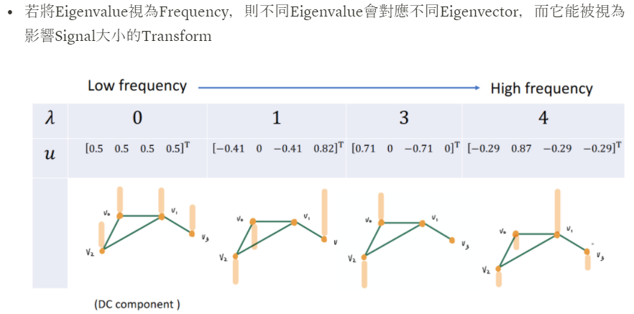
Spectral Graph Theory

Slide 15
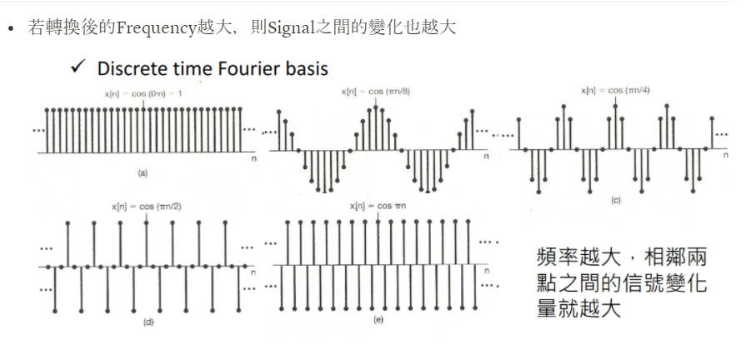
Spectral Graph Theory

Slide 16
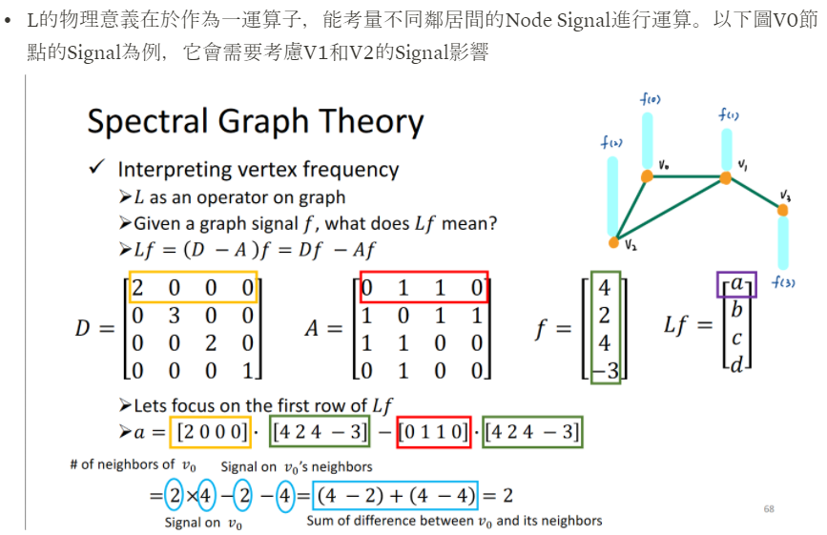
Spectral Graph Theory

Slide 17
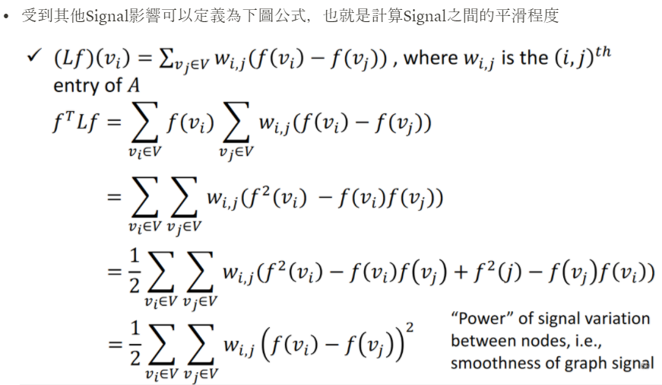
Spectral Graph Theory

Slide 18
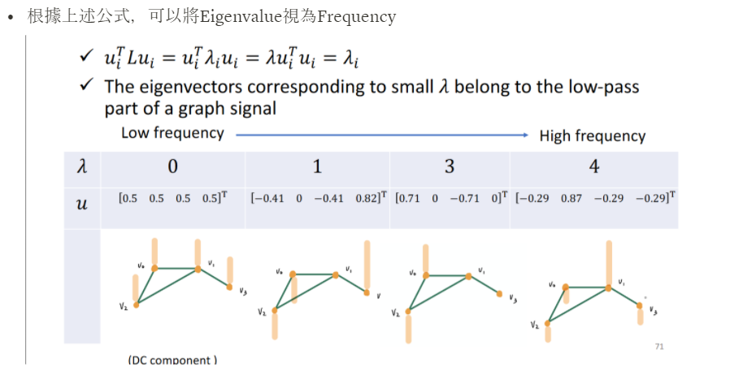
Spectral Graph Theory

Slide 19
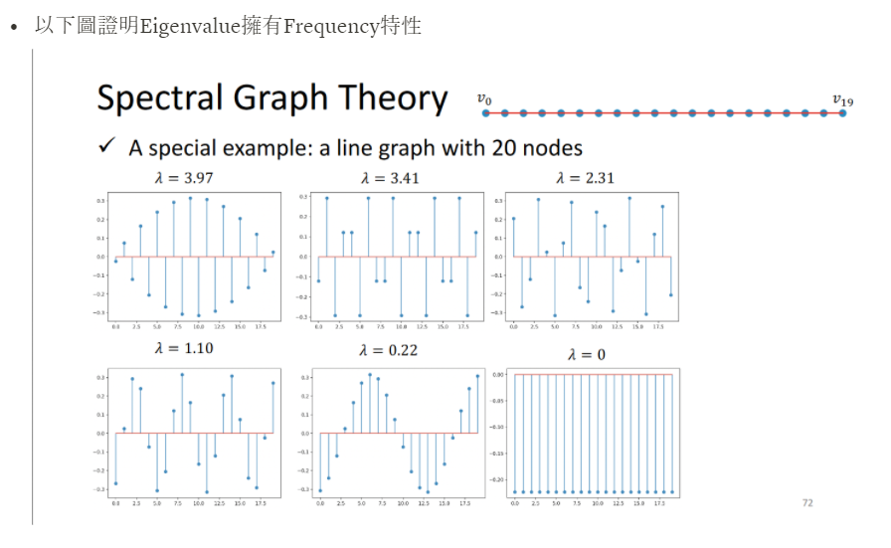
Spectral Graph Theory

Slide 20
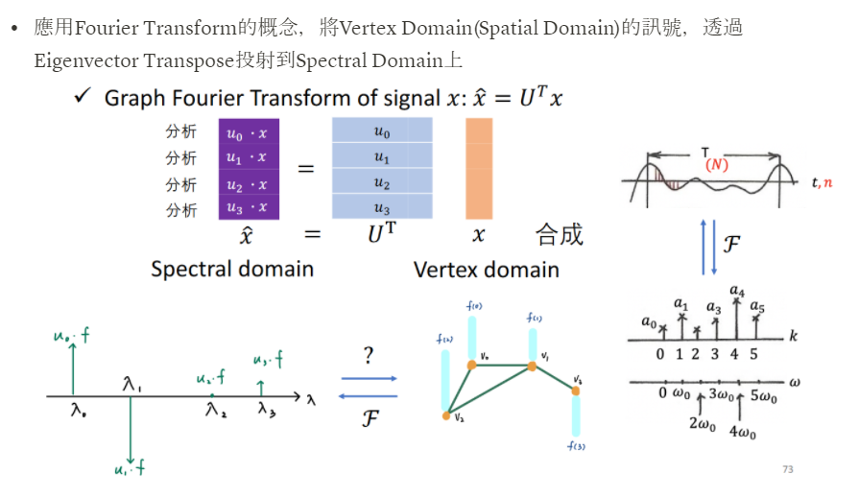
Graph Fourier Transform

Slide 21
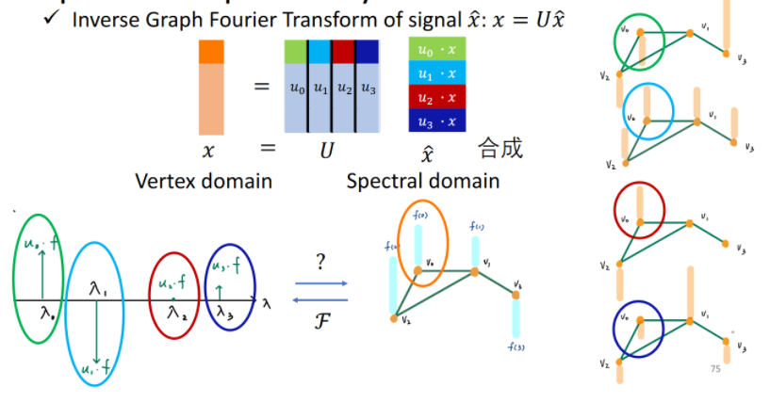
Inverse Graph Fourier Transform

Slide 22
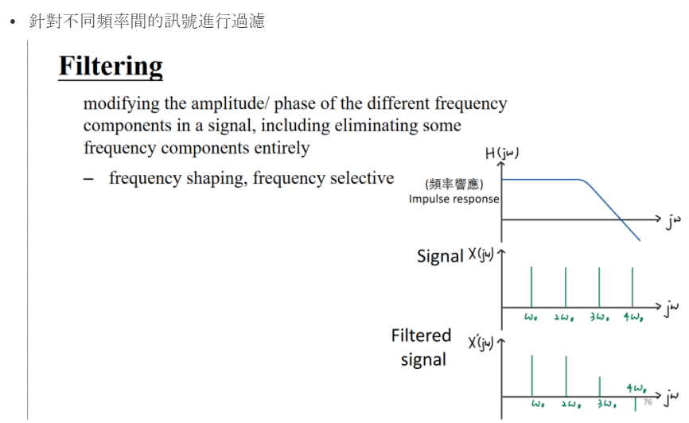
Filtering

Slide 23
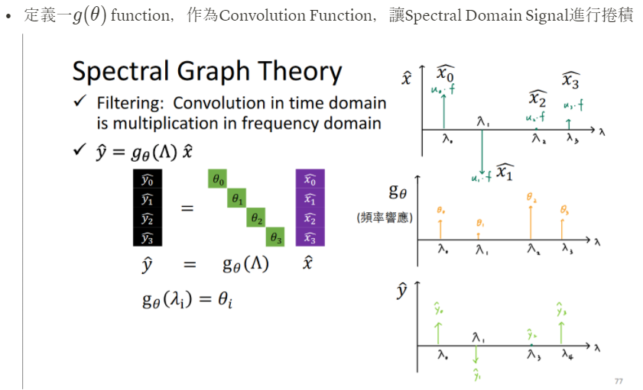
Filtering

Slide 24
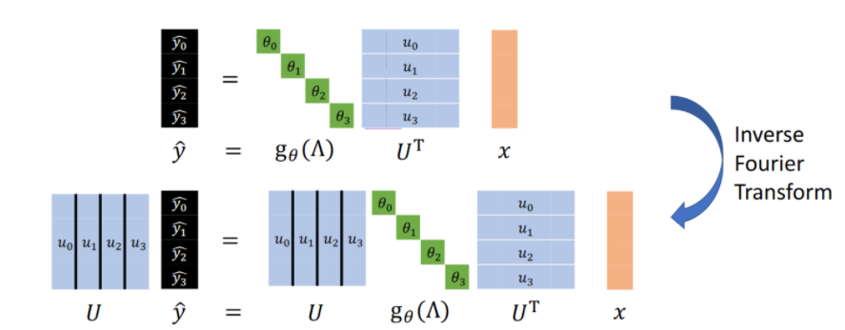
Inverse Graph Fourier Transform

Slide 25
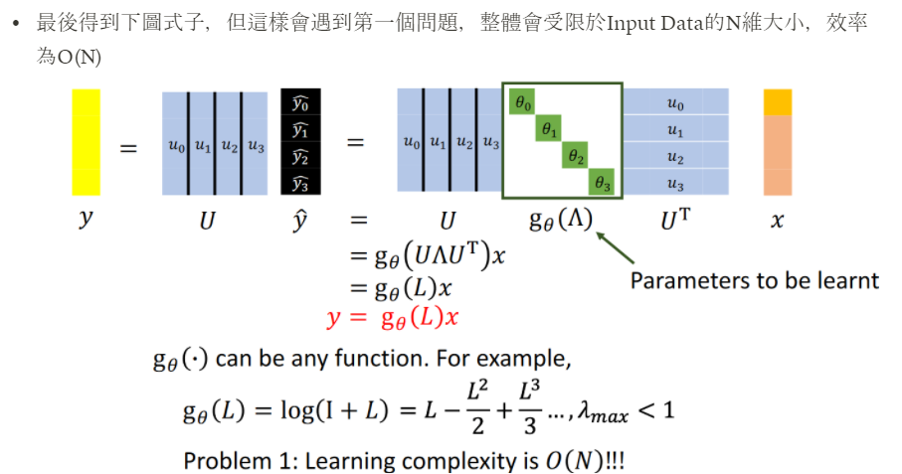
Spectral Graph Theory

Slide 26
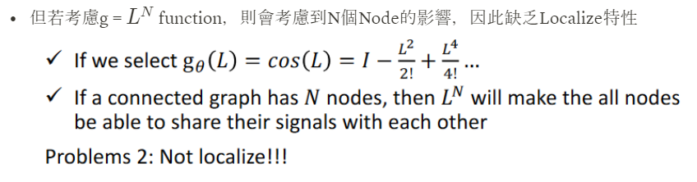
Spectral Graph Theory

Slide 27
ChebNet

Slide 28
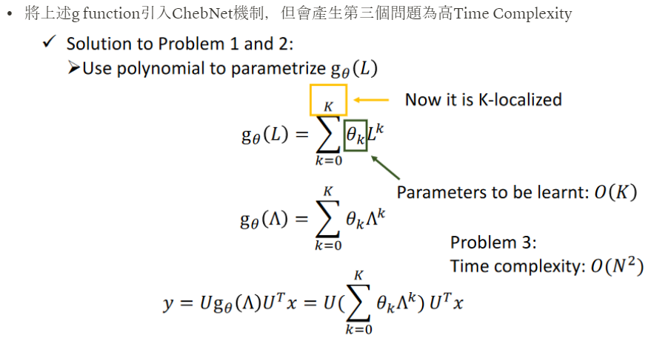

Slide 29
GCN

Slide 30
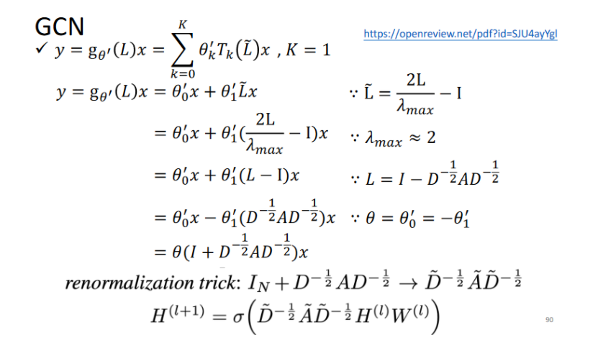

Slide 31
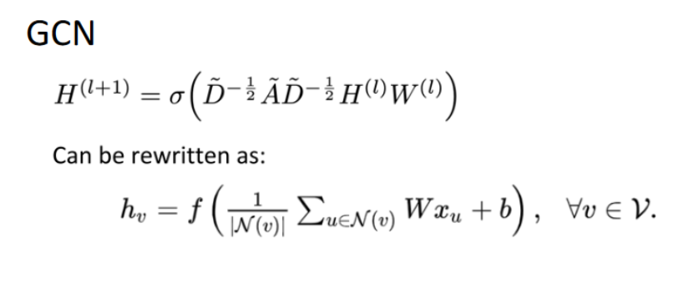

Slide 32
Adversarial attack
Max loss
反向梯度

Slide 33
Methodology

Slide 34
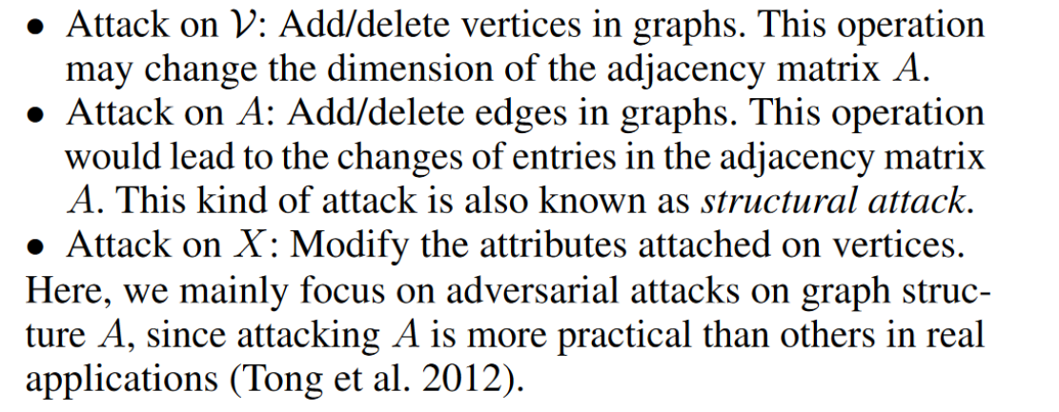
82
GF Attack

Slide 35
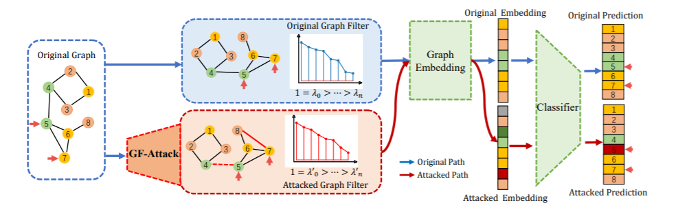
Architechture

Slide 36
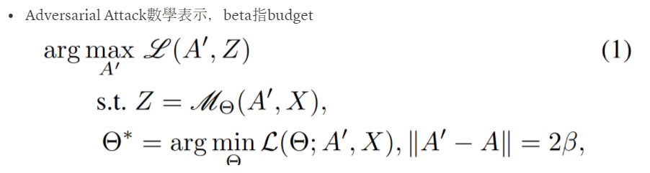
Adversarial Attack Definition

Slide 37
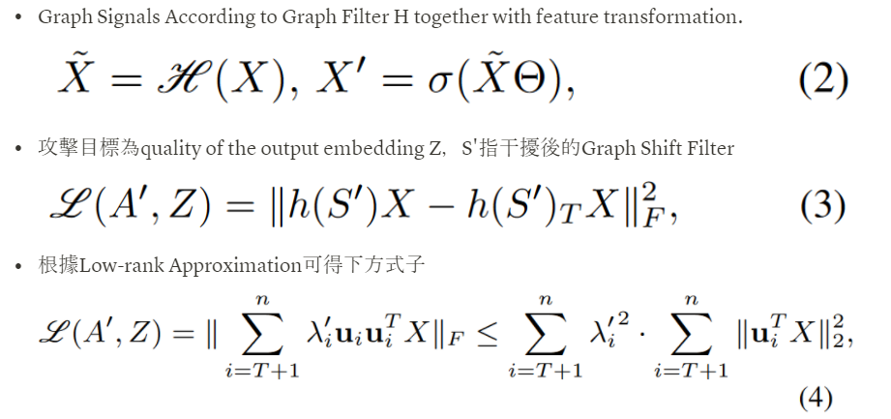
Methodologies

Slide 38
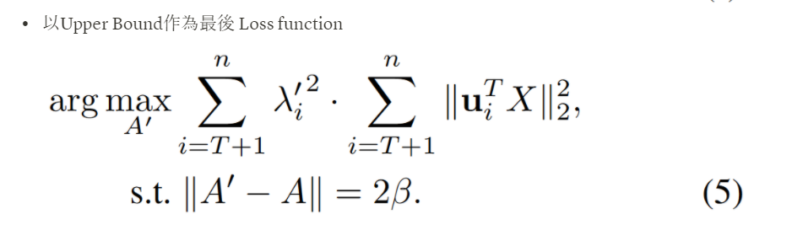
Methodologies

Slide 39
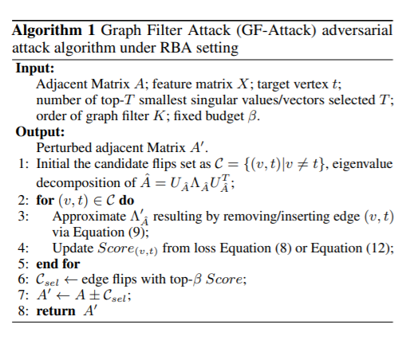
Algorithm

Slide 40
Experiment
Result

Slide 41
Dataset
scientific publications
links
unique words
classes

Slide 42
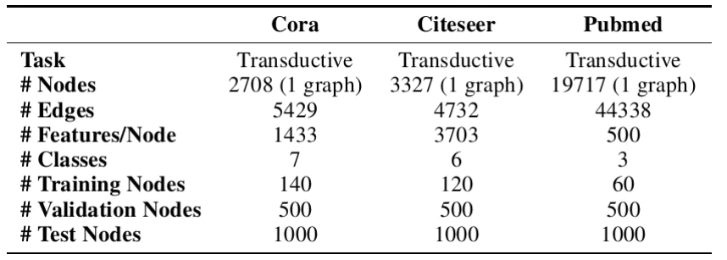
Dataset

Slide 43
Steps
train GCN
GF Attack
result

Slide 44
Our result
Cora
The test accuracy performance is: 0.8390
Final accuracy after attack is: 0.8109
Attack performance: -0.0281
Citeseer
The test accuracy performance is: 0.7465
Final accuracy after attack is: 0.73
Attack performance: -0.0165

Slide 45
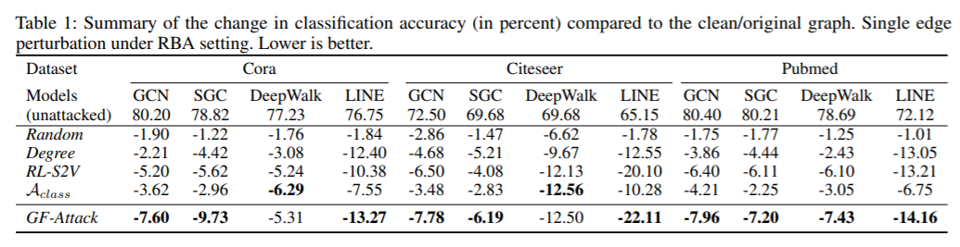

Slide 46
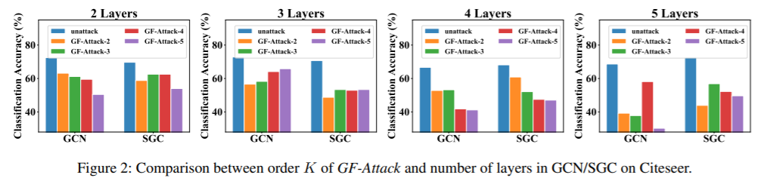

Slide 47
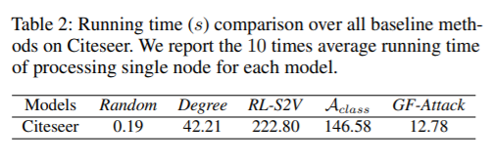

Slide 48
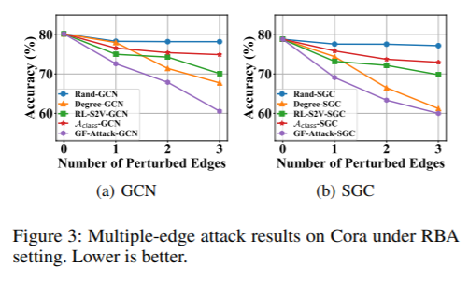

Slide 49
Reference
paper: https://arxiv.org/pdf/1908.01297.pdf
code: https://github.com/SwiftieH/GFAttack

Slide 50
Thanks

